Slide 1
THEMIS: A Mutually Verifiable Billing System
for the Cloud Computing Environment

Slide 2
Modules
Cloud Notary Authority (CNA)

Slide 3
Module Description
Cloud Notary Authority (CNA)
Cloud Notary Authority acts as a THEMIS in our cloud billing transaction. He is an authority to generate the billing transaction for the cloud service.
The CNA provides a mutually verifiable integrity mechanism that combats the malicious behavior of users or the CSP.
The process, which involves a generation of mutually verifiable binding information among all the involved entities on the basis of a one-way hash chain (One time key), is computationally efficient for a user and the CSP.
If user wants billing for the service then it sends the contract of the user and contract of CSP to the CNA.
In CNA it checks both the contract; if it is found as identical then it generates the bill as binding information and sends the confirmation message to the user and the CSP. If it is not identical then it receives the log details from the monitor.
If forgery found at user side it sends the penalty to the user. If it found at CSP side it cancels the payment to the CSP. CNA provide the billing transaction which can be verifiable and also forgery resistive in cloud environment.

Slide 4
Cloud Notary Authority (CNA)
CNA
Contract
USER
CSP Details
User Details
BILL Transaction
Bill Generation
CSP
BILL Transaction
Local Repository

Slide 5
GIVEN INPUT EXPECTED OUTPUT
Cloud Notary Authority (CNA)
Input:
contract of user and CSP from user
Output:
Generation of billing transaction
Send confirmation message to CSP and user
Monitor
Input:
Logging details of CSP
Logging details of user
Output:
Stored in repository
Send logging details to the CNA when error occurred in contract

Slide 6
/**
* @see HttpServlet#doGet(HttpServletRequest request, HttpServletResponse response)
*/
protected void doGet(HttpServletRequest request, HttpServletResponse response) throws ServletException, IOException {
// TODO Auto-generated method stub
}
try
{
String contentType = request.getContentType();
System.out.println("content type "+contentType);
if ((contentType != null) && (contentType.indexOf("multipart/form-data") >= 0)) {
DataInputStream in = new DataInputStream(request.getInputStream());

Slide 7
Cloud Notary Authority (CNA)

Slide 8
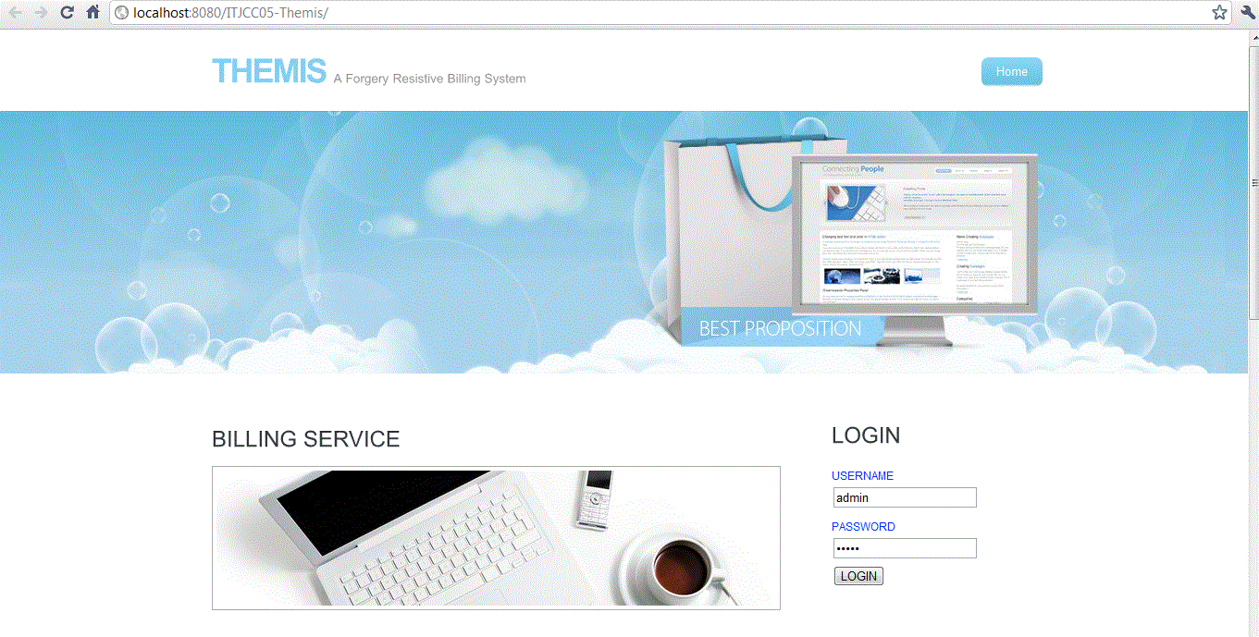
Notes:
After logging from this page, it will show new form for receiving sla copies from CSP and user.

Slide 9
